Slide 1
CMSC201 Computer Science I for Majors Lecture 15 – For Loops

Slide 2
Last Class We Covered
Two-dimensional lists
Lists and functions
Mutability
#TBT
Scope

Slide 3
Any Questions from Last Time?

Slide 4
Today’s Objectives
To learn about and be able to use a for loop
To understand the syntax of a for loop
To use a for loop to iterate through a list
To learn about the range() function
To be able to combine range() and for
To create a 2D list using loops

Slide 5
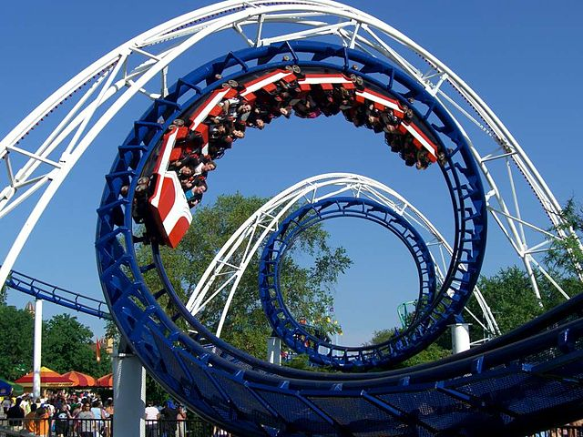
Looping (for Loops)
Looping
(for Loops)
Image from wikimedia.org
Notes:
https://commons.wikimedia.org/wiki/File:Corkscrew_(Cedar_Point)_01.jpg

Slide 6
Control Structures (Review)
A program can proceed:
In sequence
Selectively (branching): make a choice
Repetitively (iteratively): looping
By calling a function
focus of today’s lecture

Slide 7
Looping
Python has two kinds of loops, and they are used for two different purposes
The while loop
Works for basically everything
The for loop:
Best at iterating over a list
Best at counted iterations
what we’re covering today

Slide 8
for Loops: Iterating over a List

Slide 9
Iterating Through Lists
Iteration is when we move through a list, one element at a time
Iteration is best completed with a loop
We did this previously with our while loop
Using a for loop will make our code much faster and easier to write
Even faster than the while loop was to write!

Slide 10
Parts of a for Loop
Here’s some example code… let’s break it down
myList = ['a', 'b', 'c', 'd']
for listItem in myList:
print(listItem)

Slide 11
Parts of a for Loop
Here’s some example code… let’s break it down
myList = ['a', 'b', 'c', 'd']
for listItem in myList:
print(listItem)
initialize the list
how we will refer to each element
the list we want to iterate through
the body of the loop

Slide 12
How a for Loop Works
In the for loop, we declared a new variable called “listItem”
The loop changes this variable for us
The first time through the loop, listItem will be the value of the first element of the list ('a')
The second time through the loop, listItem will be the value of the second element of the list ('b')
And so on…

Slide 13
for Loop Explanation
myList =
for listItem in myList:
print(listItem)
"a"
"b"
"c"
"d"
0
1
2
3
Image from pixabay.com

Slide 14
for Loop Explanation
myList =
for listItem in myList:
print(listItem)
"a"
"b"
"c"
"d"
0
1
2
3
"a"
listItem
Image from pixabay.com

Slide 15
for Loop Explanation
myList =
for listItem in myList:
print(listItem)
"a"
"b"
"c"
"d"
0
1
2
3
"a"
listItem
a
output:
Image from pixabay.com

Slide 16
for Loop Explanation
myList =
for listItem in myList:
print(listItem)
"a"
"b"
"c"
"d"
0
1
2
3
"a"
"b"
listItem
Image from pixabay.com

Slide 17
for Loop Explanation
myList =
for listItem in myList:
print(listItem)
"a"
"b"
"c"
"d"
0
1
2
3
"b"
listItem
b
output:
Image from pixabay.com

Slide 18
for Loop Explanation
myList =
for listItem in myList:
print(listItem)
"a"
"b"
"c"
"d"
0
1
2
3
"b"
"c"
listItem
Image from pixabay.com

Slide 19
for Loop Explanation
myList =
for listItem in myList:
print(listItem)
"a"
"b"
"c"
"d"
0
1
2
3
"c"
listItem
c
output:
Image from pixabay.com

Slide 20
for Loop Explanation
myList =
for listItem in myList:
print(listItem)
"a"
"b"
"c"
"d"
0
1
2
3
"c"
"d"
listItem
Image from pixabay.com

Slide 21
for Loop Explanation
myList =
for listItem in myList:
print(listItem)
"a"
"b"
"c"
"d"
0
1
2
3
"d"
listItem
d
output:
Image from pixabay.com

Slide 22
Another Example for Loop
Write code that uses a for loop to find the average from a list of numbers
nums = [98, 75, 89, 100, 45, 82]
total = 0 # we have to initialize total to zero
for n in nums:
total = total + n # so that we can use it here
avg = total / len(nums)
print("Your average in the class is:", avg)

Slide 23
Quick Note: Variable Names
Remember, variable names should always be meaningful
And they should be more than one letter!
There’s one exception: loop variables
The context for their name is clear
You can still make them longer if you want
for n in nums:
sum = sum + n

Slide 24
Strings and for Loops
We can use a for loop on strings as well
music = "jazz"
for c in music:
print(c)
The for loop goes through the string letter by letter, and handles each one separately
j
a
z
z
What will this code do?

Slide 25
The for Loop Variable

Slide 26
Updating Loop Variable
What do you think this code does?
myList = [1, 2, 3, 4]
for listItem in myList:
listItem = 4
print("List is now:", myList)
List is now: [1, 2, 3, 4]

Slide 27
“Copying” the List Elements
The loop variable is a separate “box” from the elements of the list itself
It’s only a copy of each element’s value
Editing listItem doesn’t change the actual contents of myList
There is a way to do this, though!

Slide 28
“Copying” the List Elements
The for loop is essentially doing this:
listItem = myList[0]
listItem = 4
listItem = myList[1]
listItem = 4
# and so on...
You can see now why this doesn’t change the list

Slide 29
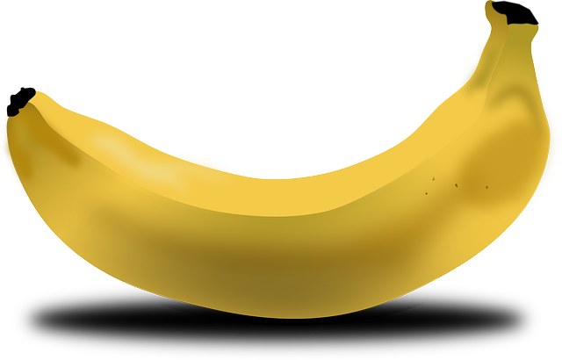
Practice: Printing a List
Given a list of strings called food, use a for loop to print out that each food is yummy!
food = ["apples", "bananas", "cherries", "durians"]
# for loop goes here
for f in food:
print(f, "are yummy!")
apples are yummy!
bananas are yummy!
cherries are yummy!
durians are yummy!
Images from pixabay.com
Notes:
https://pixabay.com/en/apple-green-fruit-juicy-nature-33709/
https://pixabay.com/en/banana-fruit-food-yellow-bent-151553/
https://pixabay.com/en/cherries-fruit-natural-diet-fresh-42904/
https://pixabay.com/en/durian-fruit-fruit-food-durio-154723/

Slide 30
The range() function

Slide 31
Range of Numbers
Python has a built-in function called range() that can generate a list of numbers
ex = list(range(0, 10))
print(ex)
cast it to a list to force it generate the numbers now
like slicing – it’s UP TO (but not including) 10
[0, 1, 2, 3, 4, 5, 6, 7, 8, 9]

Slide 32
Syntax of range()
range(start, stop, step)
the number we want to start counting at
how much we want to count by
the number we want to count UP TO (but will not include)
the name of the function

Slide 33
Examples of range()
There are three ways we can use range()
With one number
range(10)
With two numbers
range(10, 20)
With three numbers
range(10, 20, 2)

Slide 34
range() with One Number
If range() is given only one number
It will start counting at 0
And will count up to (but not including) that number
Incrementing by one
for p in range(4):
print(p)
0
1
2
3

Slide 35
range() with Two Numbers
If we give it two numbers, it will count from the first number up to the second number
for a in range(5,10):
print(a)
for b in range(10,5):
print(b)
5
6
7
8
9
range() counts up by default!

Slide 36
range() with Two Numbers
If we give it two numbers, it will count from the first number up to the second number
for c in range(-10, -5):
print(c)
-10
-9
-8
-7
-6
from a lower to a higher number

Slide 37
range() with Three Numbers
If we give it three numbers, it will count from the first number up to the second number, and it will do so in steps of the third number
>>> threeA = list(range(2, 11, 2))
>>> print(threeA)
[2, 4, 6, 8, 10]
>>> threeB = list(range(3, 28, 5))
>>> print(threeB)
[3, 8, 13, 18, 23]
range() starts counting at the first number!

Slide 38
Counting Down with range()
By default, range() counts up
But we can change this behavior
If the STEP is set to a negative number, then range() can be used to count down
>>> downA = list(range(10, 0, -1))
>>> print(downA)
[10, 9, 8, 7, 6, 5, 4, 3, 2, 1]

Slide 39
Using range() in for Loops
We can use the range() function to control a loop through “counting”
for i in range(0, 20):
print(i + 1)
What will this code do?
Print the numbers 1 through 20 on separate lines
The for loop is still iterating over a list

Slide 40
Using range() in for Loops
When we use the range() function in for loops, we don’t need to cast it to a list
The for loop handles that for us
print("Counting by fives...")
for num in range(5, 26, 5):
print(num)
5
10
15
20
25
call the range() function, but don’t need to cast it to a list

Slide 41
Combining for and range()

Slide 42
Using a for Loop with range()
We can combine a simple for loop with the range() function, as shown below
for i in range( len(theList) ):
print( theList[i] )
What’s the benefit to doing it this way?
Why do we need range() and len()?
We’ll answer these questions momentarily

Slide 43
Contents vs Indexes
Previously, we had used the for loop to iterate over the contents of the list
For example: “a”, “b”, “c”, “d”
Just now, we used the for loop to iterate over the indexes of the list
For example: 0, 1, 2, 3
Both examples are iterating over a list

Slide 44
Why range() and len()?
Why do we need len()?
To know how many indexes the list has
It will give us an integer value
Why do we need range()?
To generate all the indexes of the list
What does range() do with one number?
Start at 0, and count up to the number given

Slide 45
Common Error
Pay attention with len() and range()
Which goes on the outside?
range()
It needs the length to generate the indexes
If you use them backwards:
TypeError: 'list' object cannot be interpreted as an integer

Slide 46
Time for…
LIVECODING!!!

Slide 47
Running a Kennel
You are running a kennel with space for 5 dogs
You ask your 3 assistants to do the following, using the list of dogs in your office:
Tell you all of the dogs in the kennel
Tell you what pen number each dog is in
Later, all the dogs have been picked up, and someone dropped off their 5 German Shepherds, so the list in your office needs to be updated

Slide 48
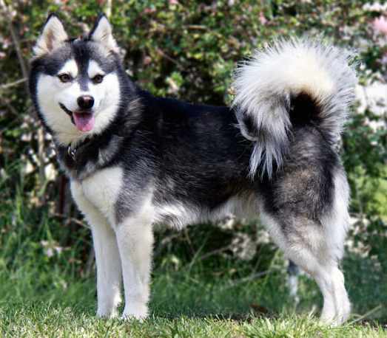
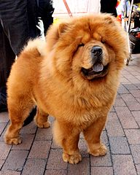
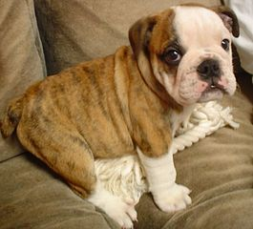
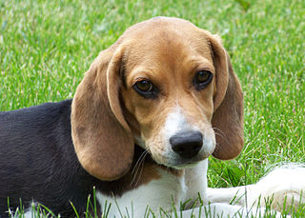
Running a Kennel
The dogs in your kennel at the start are:
Alaskan Klee Kai | Beagle | Chow Chow | Doberman | English Bulldog
Images from wikimedia.org
Notes:
https://commons.wikimedia.org/wiki/File:WOWAKK-Kukai-Alaskan-Klee-Kai.jpg
https://commons.wikimedia.org/wiki/File:Cute_beagle_puppy_lilly.jpg
https://commons.wikimedia.org/wiki/File:01_Chow_Chow.jpg
https://commons.wikimedia.org/wiki/File:Dobermannwurf.jpg
https://commons.wikimedia.org/wiki/File:English_Bulldog_puppy.jpg

Slide 49
Using Loops to Make 2D Lists
The easiest way to create a 2D list is to
Start with an empty one-dimensional list
Create the first “row” as a separate list
Append it to the original 1D list
Repeat until all rows are added to the list
You can use a while loop, but for loops are great at creating lists of a specific size

Slide 50
Example: Creating 2D List
Create a 6-high by 4-wide list of underscores
board = []
row = ["_", "_", "_", "_"]
for i in range(6):
board.append( row[:] )
why is this here?
each row needs to be individual, hence it needs to be deep copied

Slide 51
Example: Creating 2D List from Input
Create a list of names and majors for 5 students
info = []
for i in range(5):
name = input("Enter name: ")
major = input("Major? ")
row = [name, major]
info.append(row)
why doesn’t this row need to be deep copied?

Slide 52
Announcements
HW 5 out on Blackboard
Must re-take the Academic Integrity Quiz to see it
Due Friday, April 7th @ 8:59:59 PM
Discussions started again this week
Remainder of labs will be in-person
Pre Lab quizzes will come out Friday morning
Final exam is Friday, May 19th from 6 to 8 PM

